Slide 1


Advanced Web Development (AWD) course-CS163
Dr. Ishu Sharma
Department of Computer Science and Engineering
Chitkara University, Punjab
AWD

Slide 2
React Components
import React from 'react';
import ReactDOM from 'react-dom/client';
function Car() {
return <h2>Hi, I am a Car!</h2>;
}
const root = ReactDOM.createRoot(document.getElementById('root'));
root.render(<Car />);
export default Car;
AWD

Slide 3
React Components
import React from 'react';
import ReactDOM from 'react-dom/client';
function Car(props) {
return <h2>I am a {props.color} Car!</h2>;
}
const root = ReactDOM.createRoot(document.getElementById('root'));
root.render(<Car color="red"/>);
export default Car;
Output : I am a red Car!
AWD

Slide 4
Components in Components
import React from 'react';
import ReactDOM from 'react-dom/client';
function Car() {
return <h2>I am a Car!</h2>;
}
function Garage() {
return (
<>
<h1>Who lives in my Garage?</h1>
<Car />
</>
);}
const root = ReactDOM.createRoot(document.getElementById('root'));
root.render(<Garage />);
export default Car;
Output:
Who lives in my Garage?
I am a Car!
AWD

Slide 5
Components in Files
Car.js
function Car() {
return <h2>Hi, I am a Car!</h2>;
}
export default Car;
App.js
import React from 'react';
import ReactDOM from 'react-dom/client';
import Car from './Car.js';
const root = ReactDOM.createRoot(document.getElementById('root'));
root.render(<Car />);
Output:
Hi, I am a Car!
AWD

Slide 6
Create a Class Component
When creating a React component, the component's name must start with an upper case letter.
The component has to include the extends React.Component statement, this statement creates an inheritance to React.Component, and gives your component access to React.Component's functions.
The component also requires a render() method, this method returns HTML.
class Car extends React.Component {
render() {
return <h2>Hi, I am a Car!</h2>;
}
}
Now your React application has a component called Car, which returns a <h2> element.
To use this component in your application, use similar syntax as normal HTML: <Car />
AWD

Slide 7
Create a Class Component
import React from 'react';
import ReactDOM from 'react-dom/client';
class Car extends React.Component {
render() {
return <h2>Hi, I am a Car!</h2>;
}
}
ReactDOM.render(<Car />, document.getElementById('root'));
Output:
Hi, I am a Car!
AWD

Slide 8
Component Constructor
If there is a constructor() function in your component, this function will be called when the component gets initiated.
The constructor function is where you initiate the component's properties.
In React, component properties should be kept in an object called state.
The constructor function is also where you honor the inheritance of the parent component by including the super() statement, which executes the parent component's constructor function, and your component has access to all the functions of the parent component (React.Component).
AWD

Slide 9
Component Constructor
class Car extends React.Component {
constructor() {
super();
this.state = {color: "red"};
}
render() {
return <h2>I am a Car!</h2>;
}
}
import React from 'react';
import ReactDOM from 'react-dom/client';
class Car extends React.Component {
render() {
return <h2>Hi, I am a Car!</h2>;
}
}
ReactDOM.render(<Car />, document.getElementById('root'));
AWD

Slide 10
Component Constructor
import React from 'react';
import ReactDOM from 'react-dom/client';
class Car extends React.Component {
constructor() {
super();
this.state = {color: "red"};
}
render() {
return <h2>I am a {this.state.color} Car!</h2>;
}
}
const root = ReactDOM.createRoot(document.getElementById('root'));
root.render(<Car />);
AWD

Slide 11
Props
Another way of handling component properties is by using props.
Props are like function arguments, and you send them into the component as attributes.
import React from 'react';
import ReactDOM from 'react-dom/client';
class Car extends React.Component {
render() {
return <h2>I am a {this.props.color} Car!</h2>;
}
}
ReactDOM.render(<Car color="red"/>, document.getElementById('root'));
AWD

Slide 12
Props in Constructor
If your component has a constructor function, the props should always be passed to the constructor and also to the React.Component via the super() method.
import React from 'react';
import ReactDOM from 'react-dom/client';
class Car extends React.Component {
constructor(props) {
super(props);
}
render() {
return <h2>I am a {this.props.model}!</h2>;
}
}
const root = ReactDOM.createRoot(document.getElementById('root'));
root.render(<Car model="Mustang"/>);
AWD

Slide 13
Components in Components
import React from 'react';
import ReactDOM from 'react-dom/client';
class Car extends React.Component {
render() {
return <h2>I am a Car!</h2>;
}}
class Garage extends React.Component {
render() {
return (
<div>
<h1>Who lives in my Garage?</h1>
<Car />
</div>
);
}}
const root = ReactDOM.createRoot(document.getElementById('root'));
root.render(<Garage />);
AWD

Slide 14
Components in files
React is all about re-using code, and it can be smart to insert some of your components in separate files.
To do that, create a new file with a .js file extension and put the code inside it:
Note that the file must start by importing React (as before), and it has to end with the statement export default Car;.
Example
Car.js:
import React from 'react';
class Car extends React.Component {
render() {
return <h2>Hi, I am a Car!</h2>;
}
}
export default Car;
AWD

Slide 15
Components in files
import React from 'react';
import ReactDOM from 'react-dom/client';
import Car from './Car.js';
ReactDOM.render(<Car />, document.getElementById('root'));
AWD

Slide 16
Component State
React Class components have a built-in state object.
You might have noticed that we used state earlier in the component constructor section.
The state object is where you store property values that belongs to the component.
When the state object changes, the component re-renders.
Creating the state Object
The state object is initialized in the constructor:
Example
Specify the state object in the constructor method:
class Car extends React.Component {
constructor(props) {
super(props);
this.state = {brand: "Ford"};
} render() { return (
<div>
<h1>My Car</h1>
</div>
); }}
AWD

Slide 17
Component State
The state object can contain as many properties as you like:
Example
Specify all the properties your component need:
class Car extends React.Component {
constructor(props) {
super(props);
this.state = {
brand: "Ford",
model: "Mustang",
color: "red",
year: 1964
}; }
render() {
return (
<div>
<h1>My Car</h1>
</div>
); }}
AWD

Slide 18
Using State Object
Refer to the state object anywhere in the component by using the this.state.propertyname syntax:
import React from 'react';
import ReactDOM from 'react-dom/client';
class Car extends React.Component {
constructor(props) {
super(props);
this.state = {
brand: "Ford",
model: "Mustang",
color: "red",
year: 1964
}; }
render() { return (
<div>
<h1>My {this.state.brand}</ h1>
<p> It is a {this.state.color}
{this.state.model}
from {this.state.year}.
</p>
</div>
); }}ReactDOM.render(<Car />, document.getElementById('root'));
AWD

Slide 19
Changing the state Object
import React from 'react';
import ReactDOM from 'react-dom/client';
class Car extends React.Component {
constructor(props) {
super(props);
this.state = {
brand: "Ford",
model: "Mustang",
color: "red",
year: 1964
};
}
changeColor = () => {
this.setState({color: "blue"});
}
render() {
return (
<div>
<h1>My {this.state.brand}</h1>
<p>
It is a {this.state.color}
{this.state.model}
from {this.state.year}.
</p>
<button
type="button"
onClick={this.changeColor}
>Change color</button>
</div>
);
}
}
const root = ReactDOM.createRoot(document.getElementById('root'));
root.render(<Car />);
AWD

Slide 20
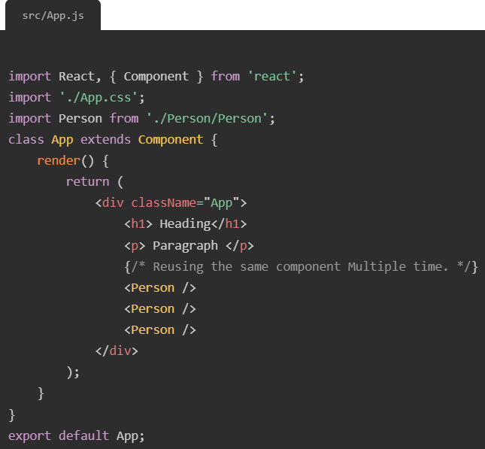
Reusable Components
Reusable components can be requirements specifications, design documents, source code, user interfaces, user documentation, or any other items associated with software. All products resulting from the software development life cycle have the potential for reuse.
For example;
AWD

Slide 21
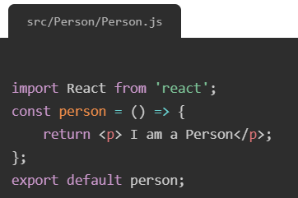
Working with Components & Re-using them
If our Application contains more and more components and use them wherever we need to use in our app.
<Person />: This is now effectively our custom HTML element. We also can configure it though before we do that, let’s change something else about our react code because right now is all static, still we have our custom component but in there we are still using some static HTML in the end.
JSX code should be dynamic and it should output different thing depending on the state of our application or on some user input.
AWD

Slide 22
Dynamic Content in JSX
<p> I am a Person and I am X year old! </p> but X should actually be a random number, and we can simply do that. We can replace X with a random number.
Changes in ~~~ Src/Person/Person.js
import React from 'react';
const person = () => {
return <p> I am a Person and i am Math.floor(Math.random() * 30) year old!</p>;
};
export default person;
To execute;
Math.floor(Math.random() * 30) //as javascript
If we have some dynamic content in our JSX part which we want to run as javascript code and not interpret as text.
For that we have to wrap into single curly braces i.e. { /* Javascript code */}
AWD

Slide 23
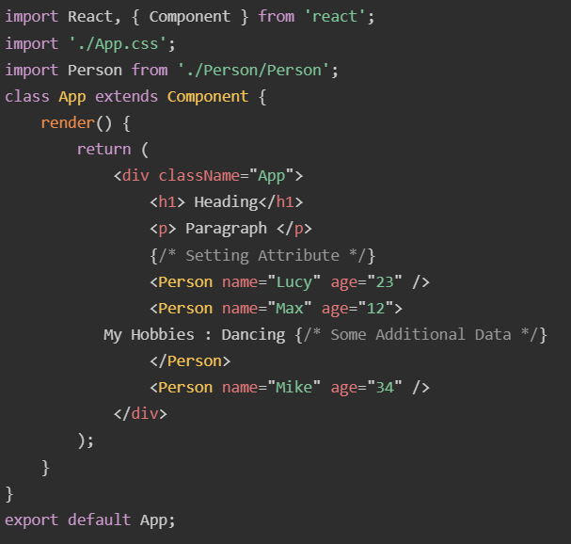
Working with Props
It is an object which stores the value of attributes of a tag and work similar to the HTML attributes. It gives a way to pass data from one component to other components. It is similar to function arguments. Props are passed to the component in the same way as arguments passed in a function.
Src/App.js
AWD

Slide 24
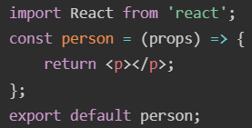
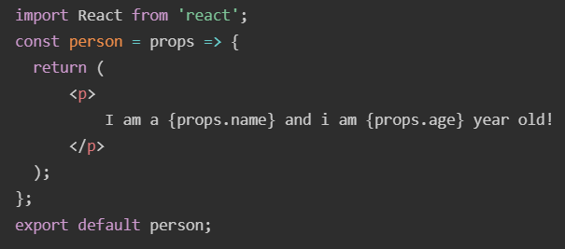
Using React Properties
The Person component can take the attribute and give us access inside the receiving component on object named props.
In javascript file;
One argument which is passed into it by default in React which is an object with all the properties of this component.
We have props through which we can get access for that name and age.
In javascript file;
AWD

Slide 25
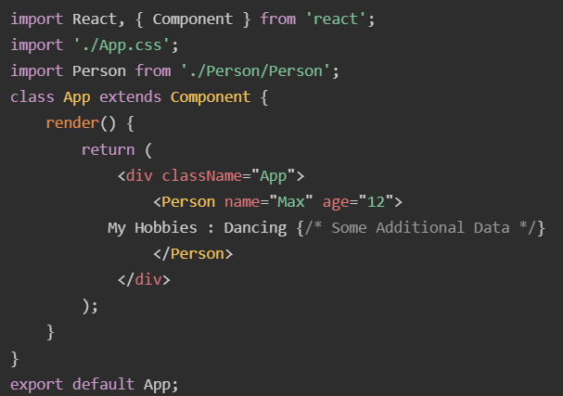
Understanding the “Children” Props
Children Property:
Now we also want to output whatever we pass between the opening and closing tag of our custom component.
AWD

Slide 26
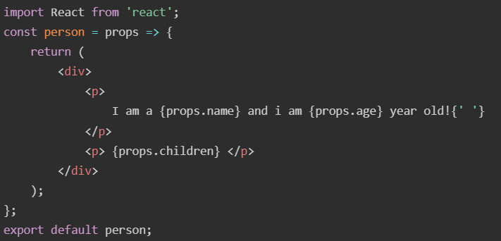
Understanding the “Children” Props
Children Property:
In the Person component, where we want to receive it in the end will wrap our paragraph in normal parentheses.
New p element inside the container div element. The second p element will output the content which we have passed between the Person element in src/App.js.
AWD

Slide 27
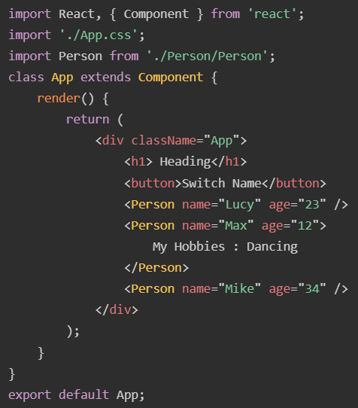
Understanding Using State
The state in a component can change over time. The change in state over time can happen as a response to user action or system event. A component with the state is known as stateful components. It is the heart of the react component which determines the behavior of the component and how it will render. They are also responsible for making a component dynamic and interactive.For example, In App.js file,
AWD

Slide 28
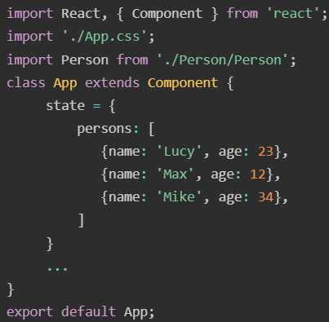
Understanding Using State
To define a state, you have to first declare a default set of values for defining the component's initial state. To do this, add a class constructor which assigns an initial state using the state. The state property can be rendered inside render() method.
AWD

Slide 29
Understanding Using State
class App extends Component {
state = {persons: [{ name: 'Lucy', age: 23 }, { name: 'Max', age: 12 }, { name: 'Mike', age: 34 }],
};
render() {
return (
<div className="App">
<h1> Heading</h1>
<button>Switch Name</button>
<Personname={this.state.persons[0].name} age={this.state.persons[0].age} /> {/* this. reffers to this class */}
{/* goes on till number of persons in array*/}
</div>);}}
export default App;
AWD

